Slide 1

Financial Technology
GOH EE WENG -23008079

Slide 2

Problem Statement
create an online business proposal to address customer pain points or challenges in the financial services sector
prototype to life as an interactive website mockup* using HTML, CSS, and JavaScript.

Slide 3

Challenges Of Financial Sectors
Need to digitise processes and services while staying competitive
Trust and credibility
Competition from traditional industry Institutions
Tracking of Personal Finance records
Making sure Investing Platform are following regulation.

Slide 4

Who are the ones Affected
Clients : Personal Informations are being shared
Shareholders: Having a Share in the business
MAS: regulating FIs to make sure that every FIs are following the regulations

Slide 5

MAS regulation
Market Conduct and Transparency-
Promotes Market integrity & transparency in the industry by setting standards
Provide clear and accurate information to clients about products& services (e.g risks, fees e.t.c)
Financial Services and Markets Bill passed to enhance MAS’ regulatory and enforcement framework across the financial sector: Allen & Gledhill (allenandgledhill.com)
Regulation (mas.gov.sg)

Slide 6

MAS Regulation
Conduct of Business Guidelines
Client Suitability Assessment
Disclosure Of Information
Conflicts Of Interest Management
Fair Dealing Practices

Slide 7
MAS Regulation
Anti-Money Laundering (AML)
Requires financial institutions to implement robust AML/CFT measures preventing money laundering & terrorist financing activities
CFT-> Countering the Financing of Terrorism
Conducting CDD
Monitoring Of Client Transactions
Reporting suspicious activities to the authorities

Slide 8

Solutions
Creating of a website
Website consists of
EKYC
Advisors (Communicating online[Whatsapp, phonecalls, texts, meetups])
P2P lending
Personal Finance tracking tools

Slide 9
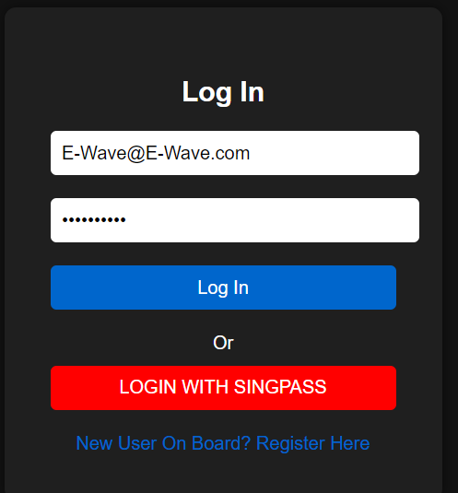
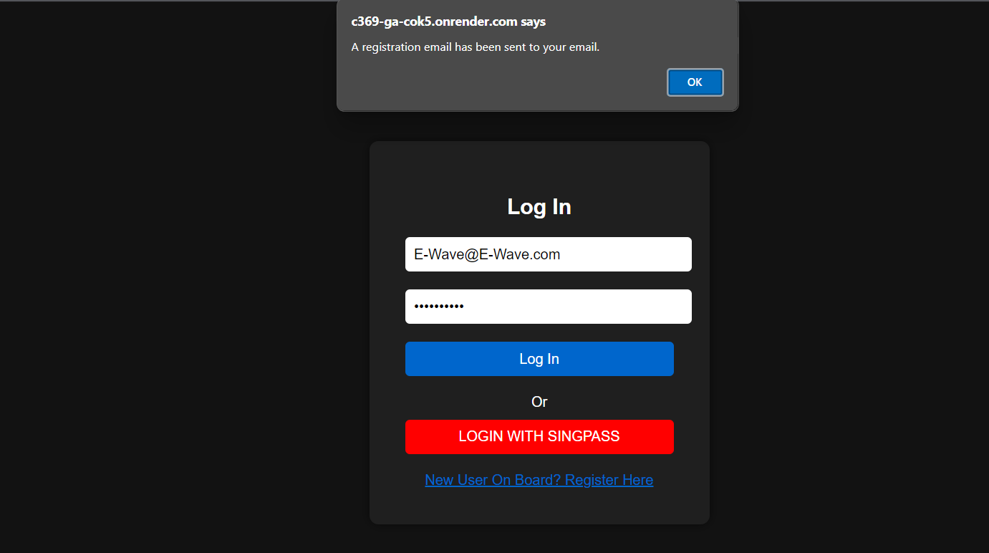
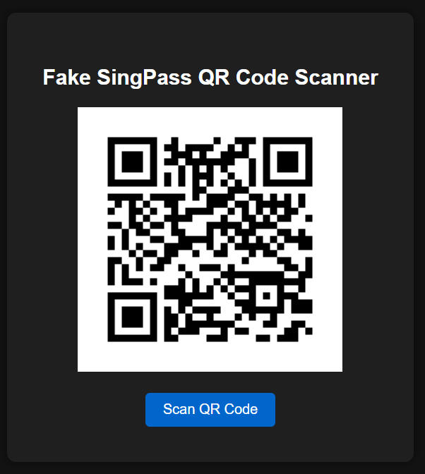
Log in/ Registration page

Slide 10
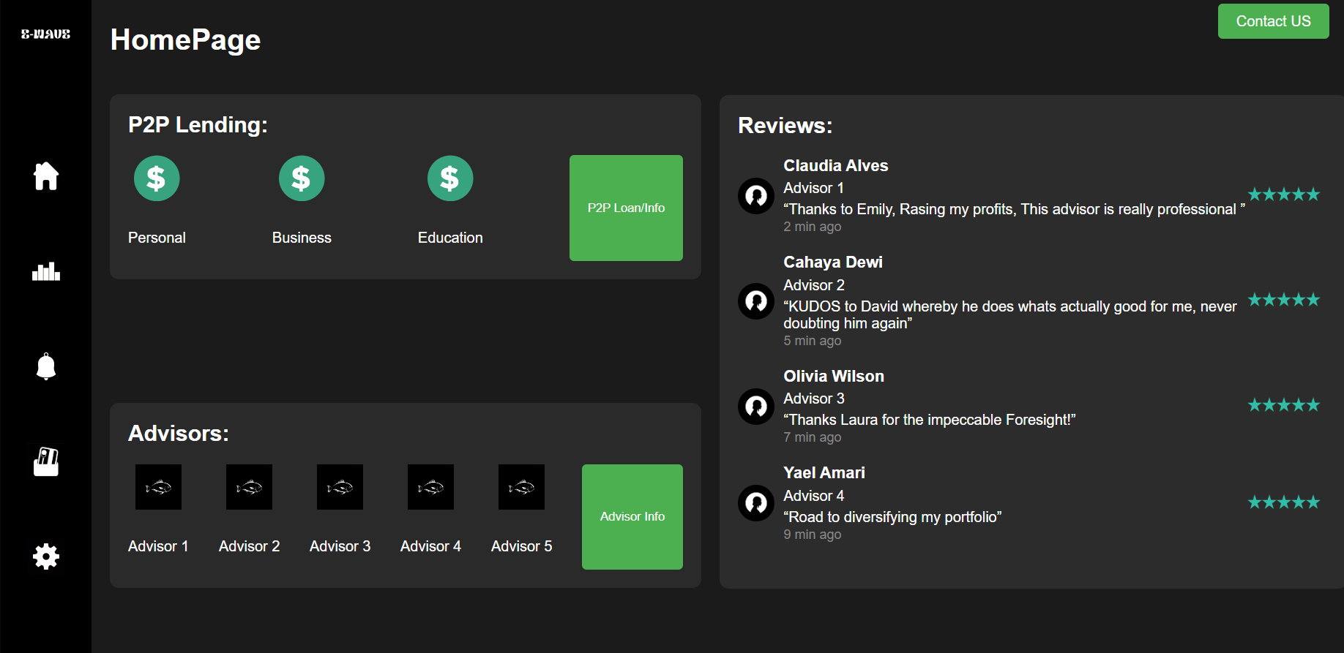

Slide 11
Advisors
Advisor will be online when market is open.
Advisors will gain more leads through the website by them calling.
Advisors will also be interacting with their clients/ potential clients
Advisors will make a risk assessment personally
First session will be free

Slide 12
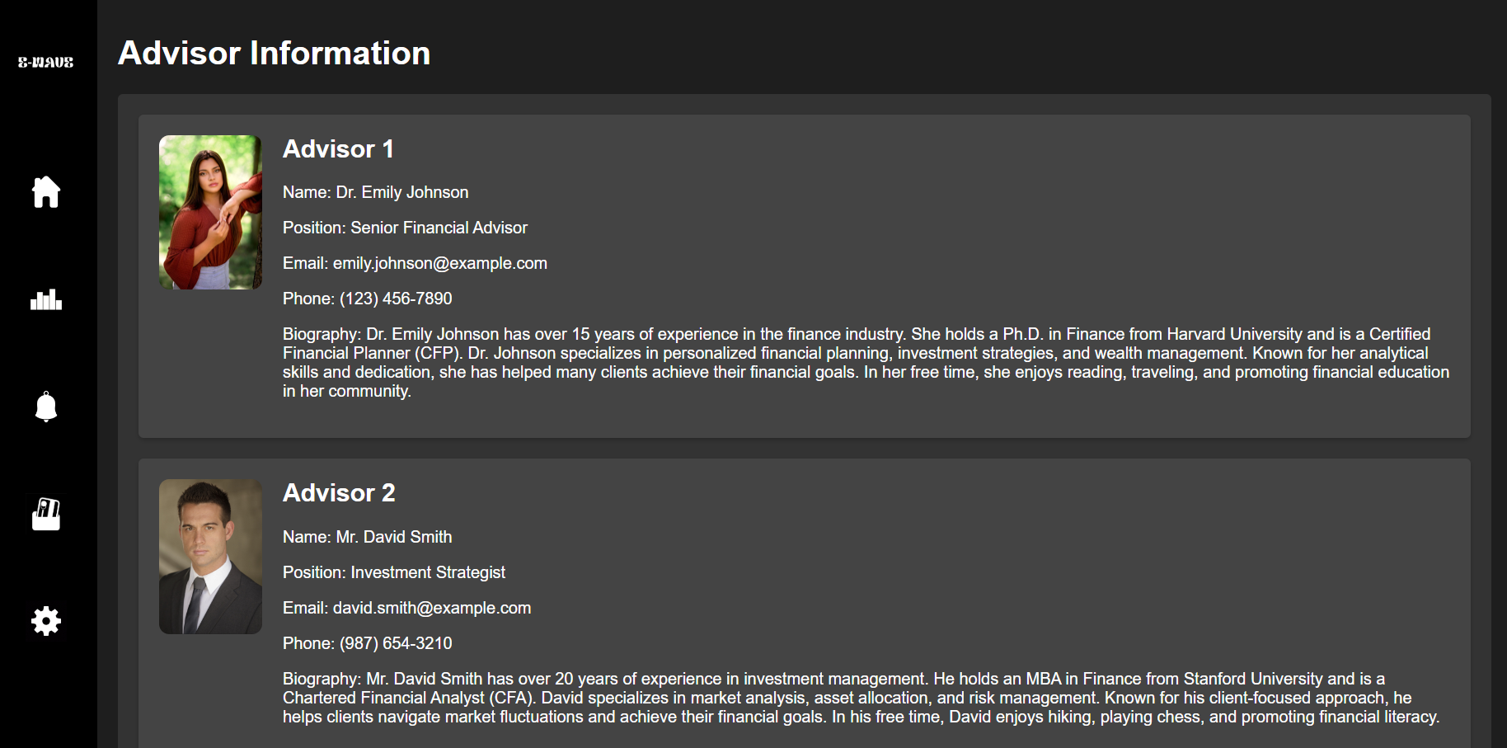
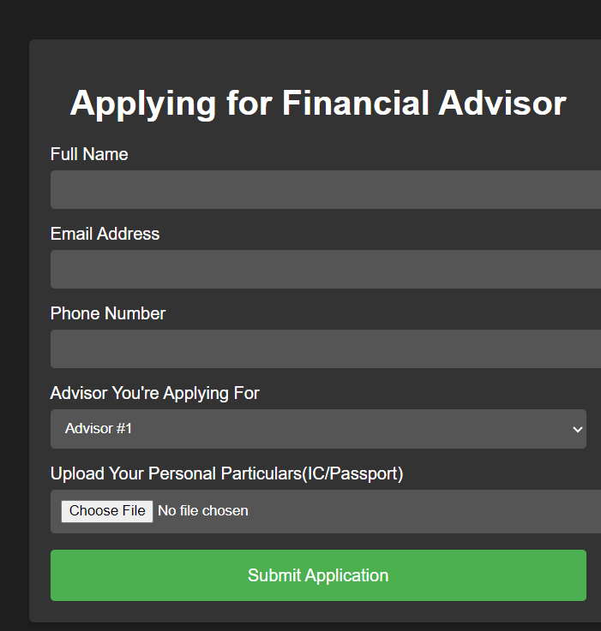
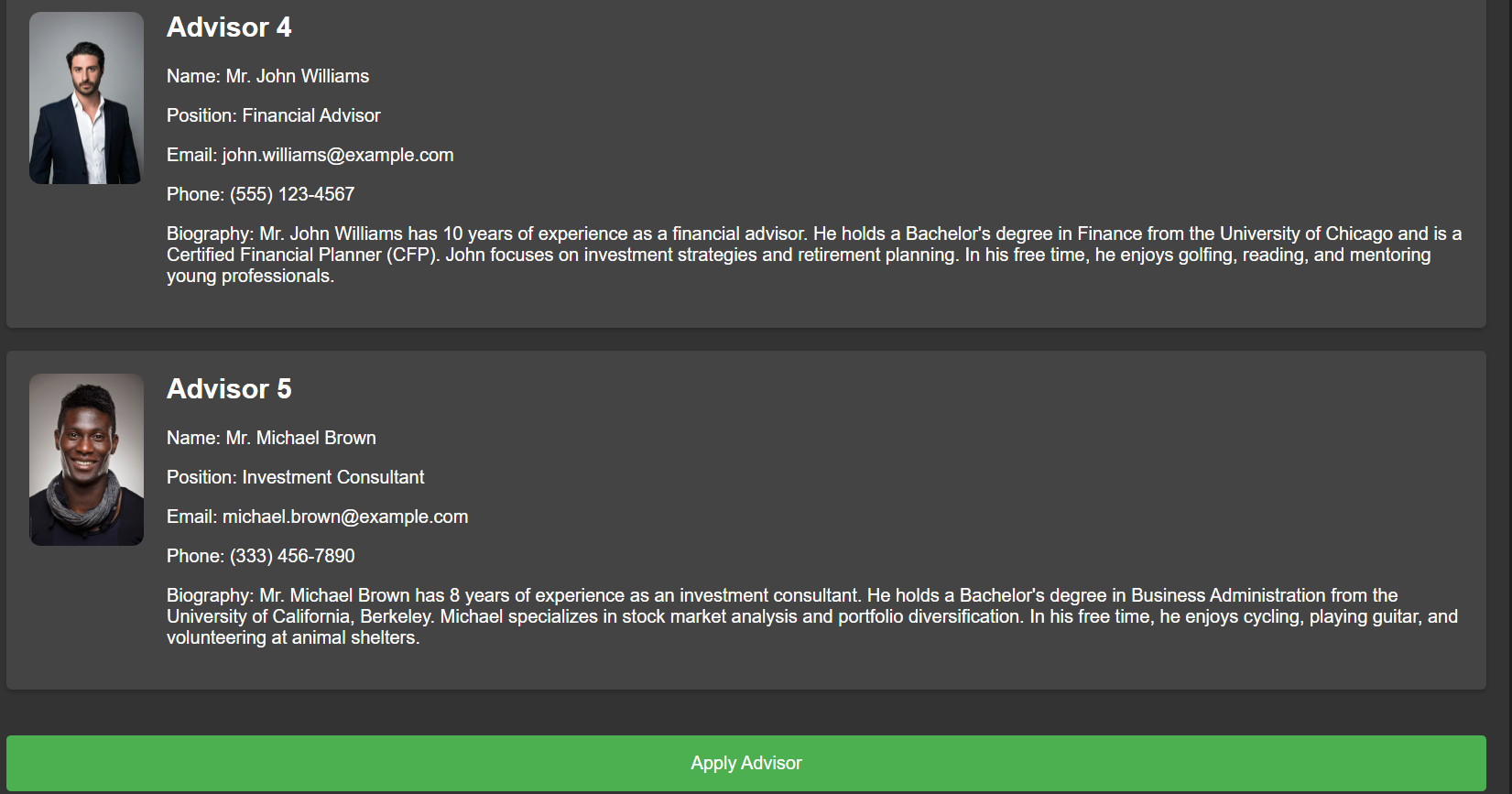

Slide 13
P2P Lending
Connects investors with borrowers
Allows borrowers to lend money directly to others
Allows borrowers to earn interest.
Saves a lot of time

Slide 14
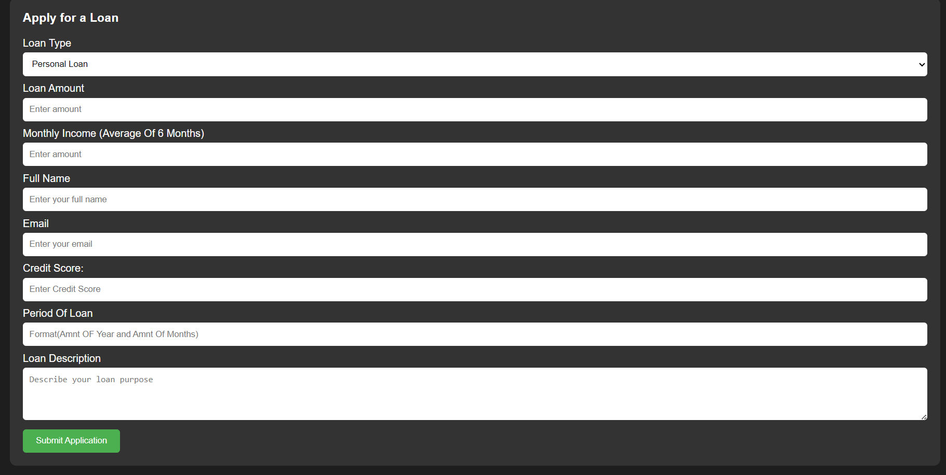
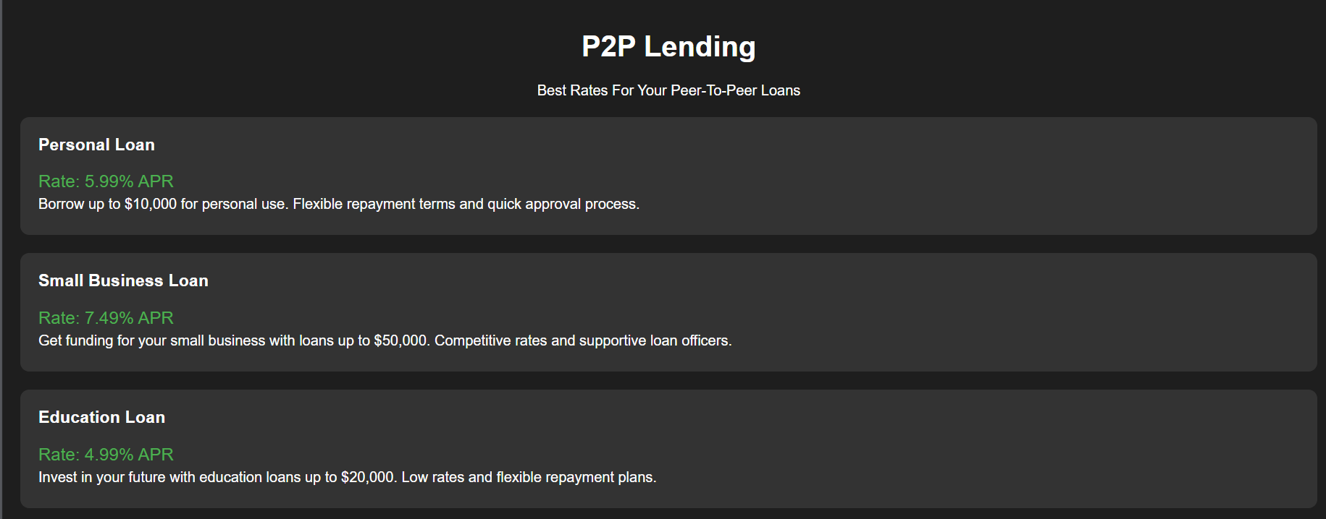

Slide 15
Personal Finance Tracking Tool
Tool that helps individuals
Track spending
Set financial goals
Optimize savings & investment

Slide 16
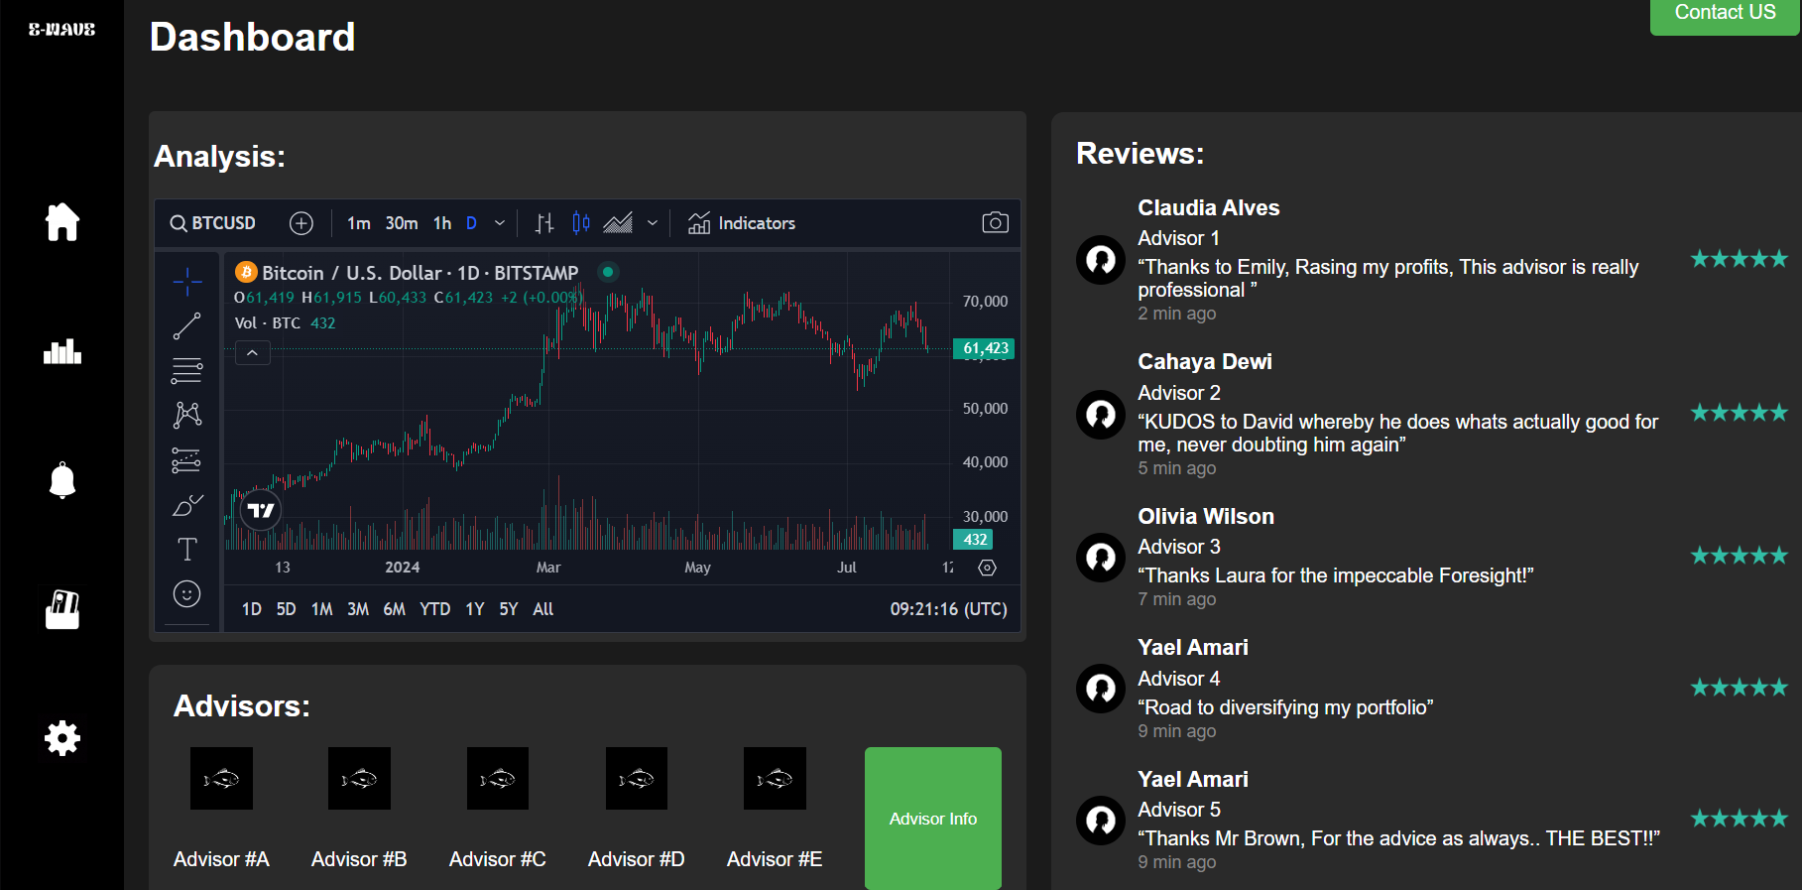

Slide 17
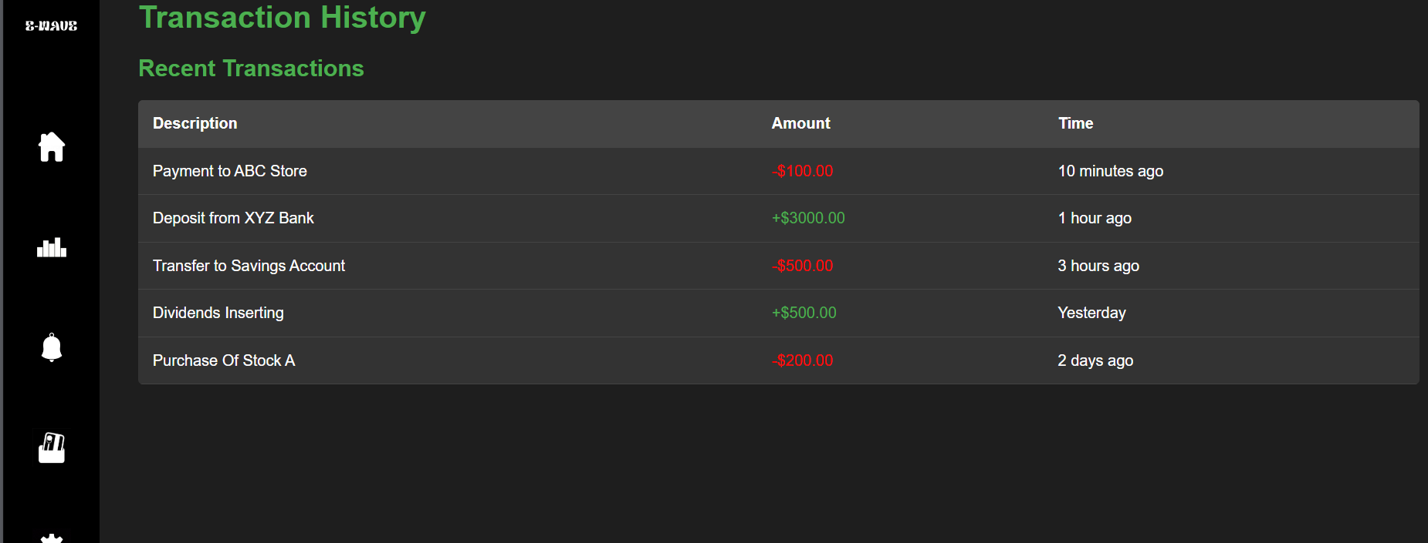
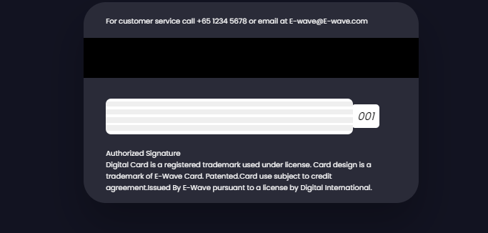
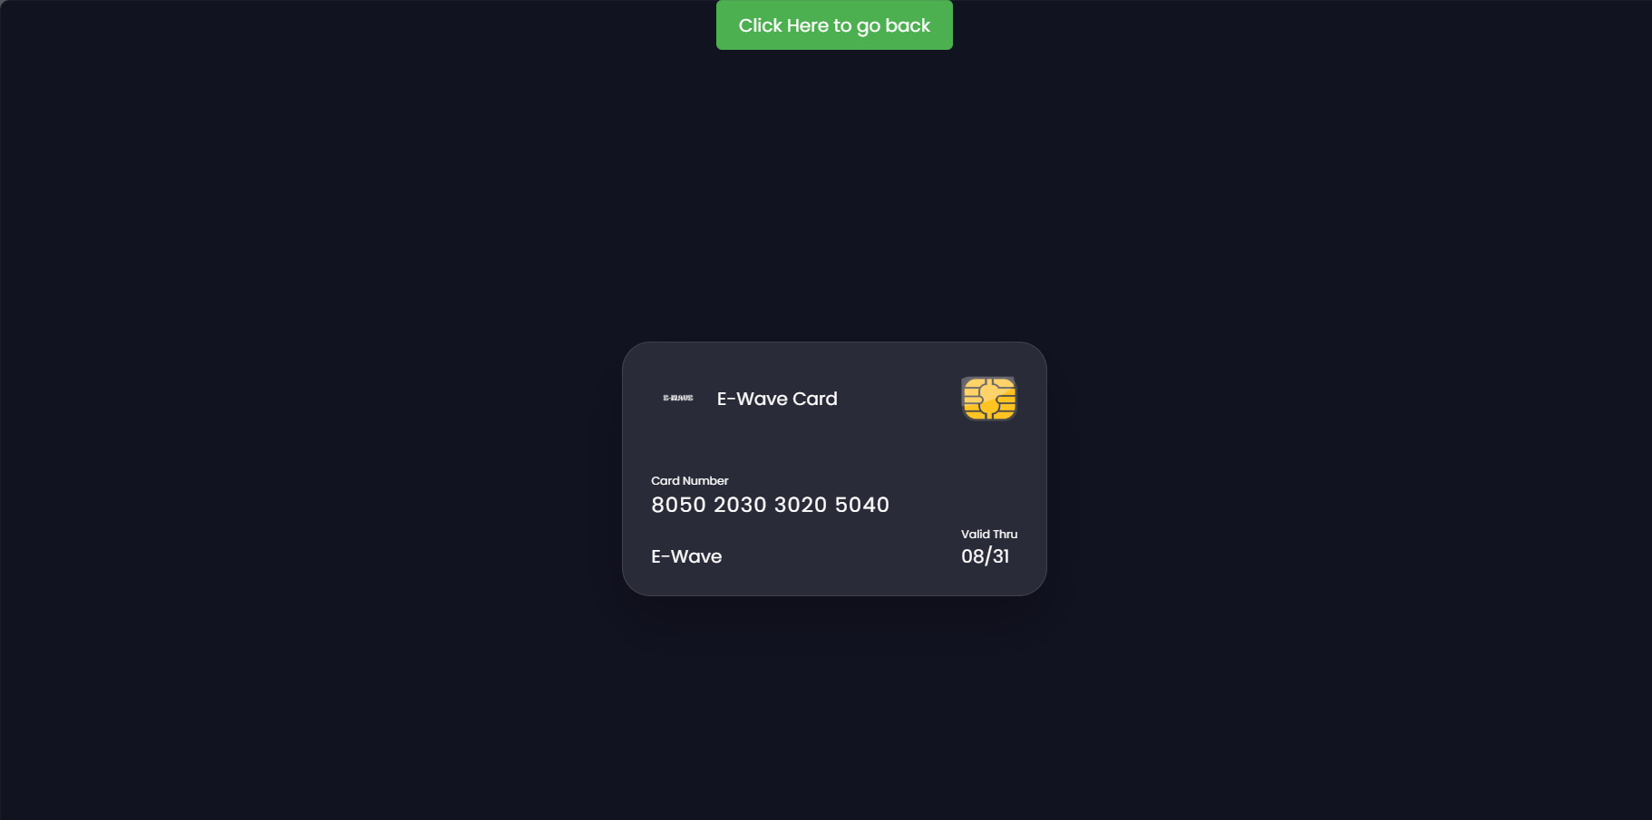
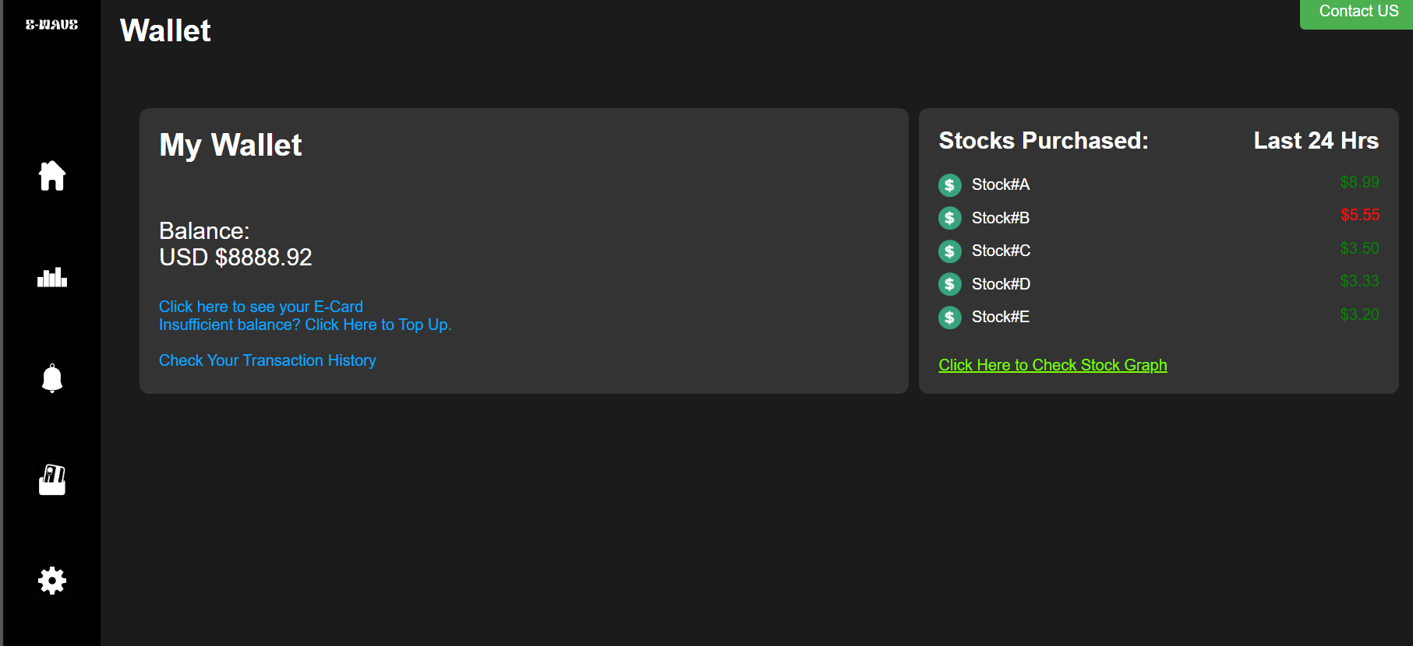
Wallet
Digital wallet
Presentation of E-Card
Topping Up money into wallet
Transaction History

Slide 18
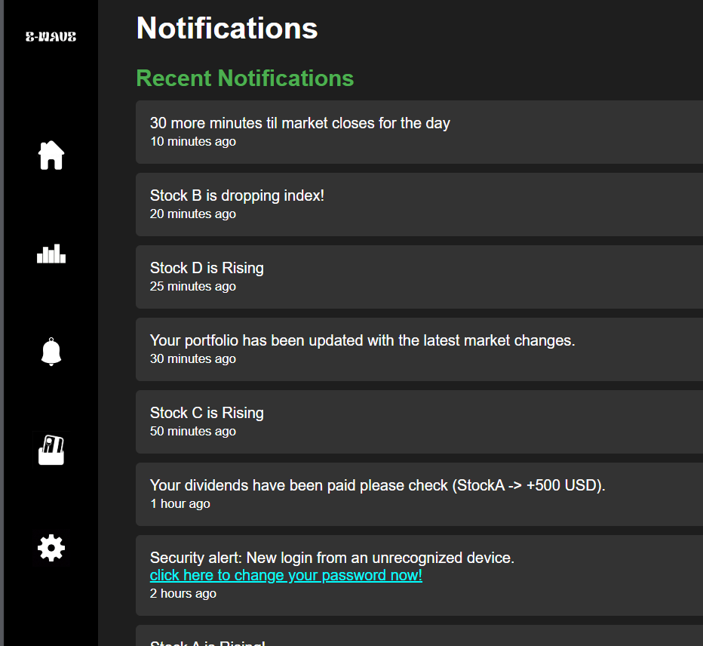
Notification
Allows you to read notification easily
Able to Click on links on important pages like changing password.

Slide 19
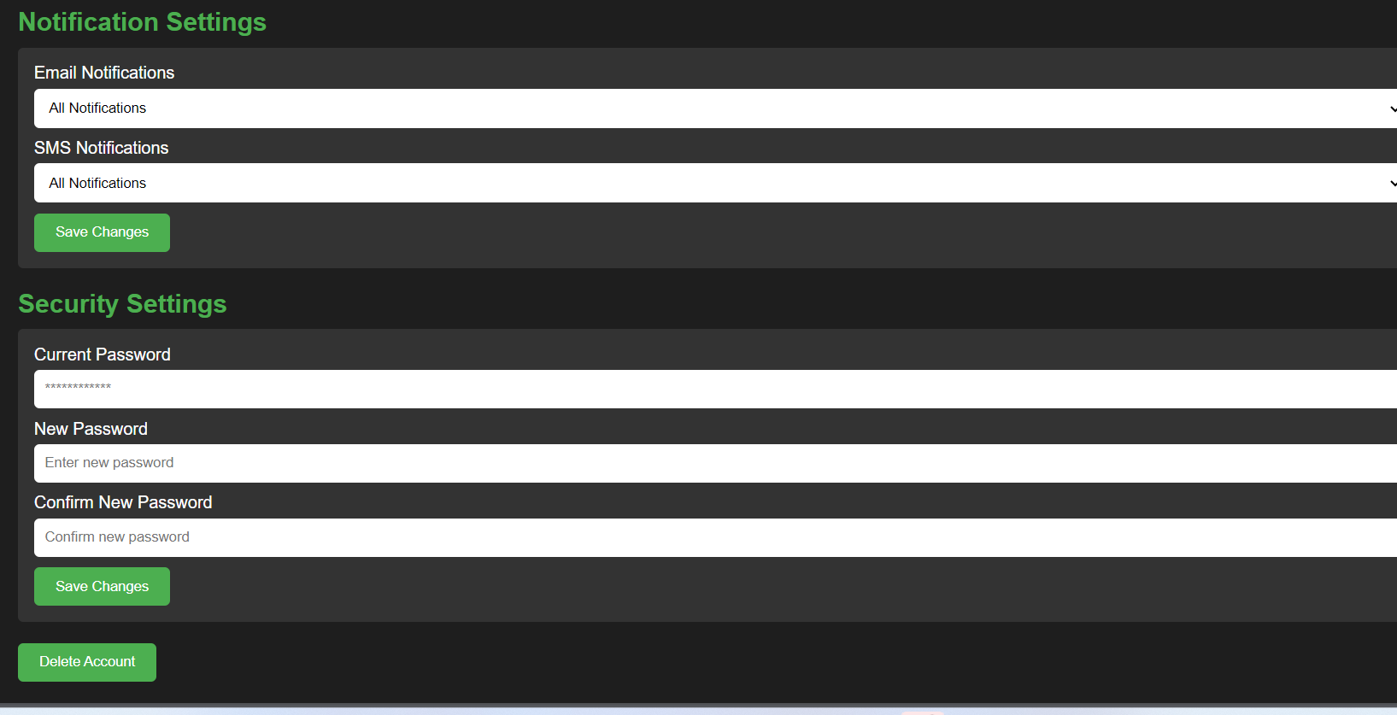
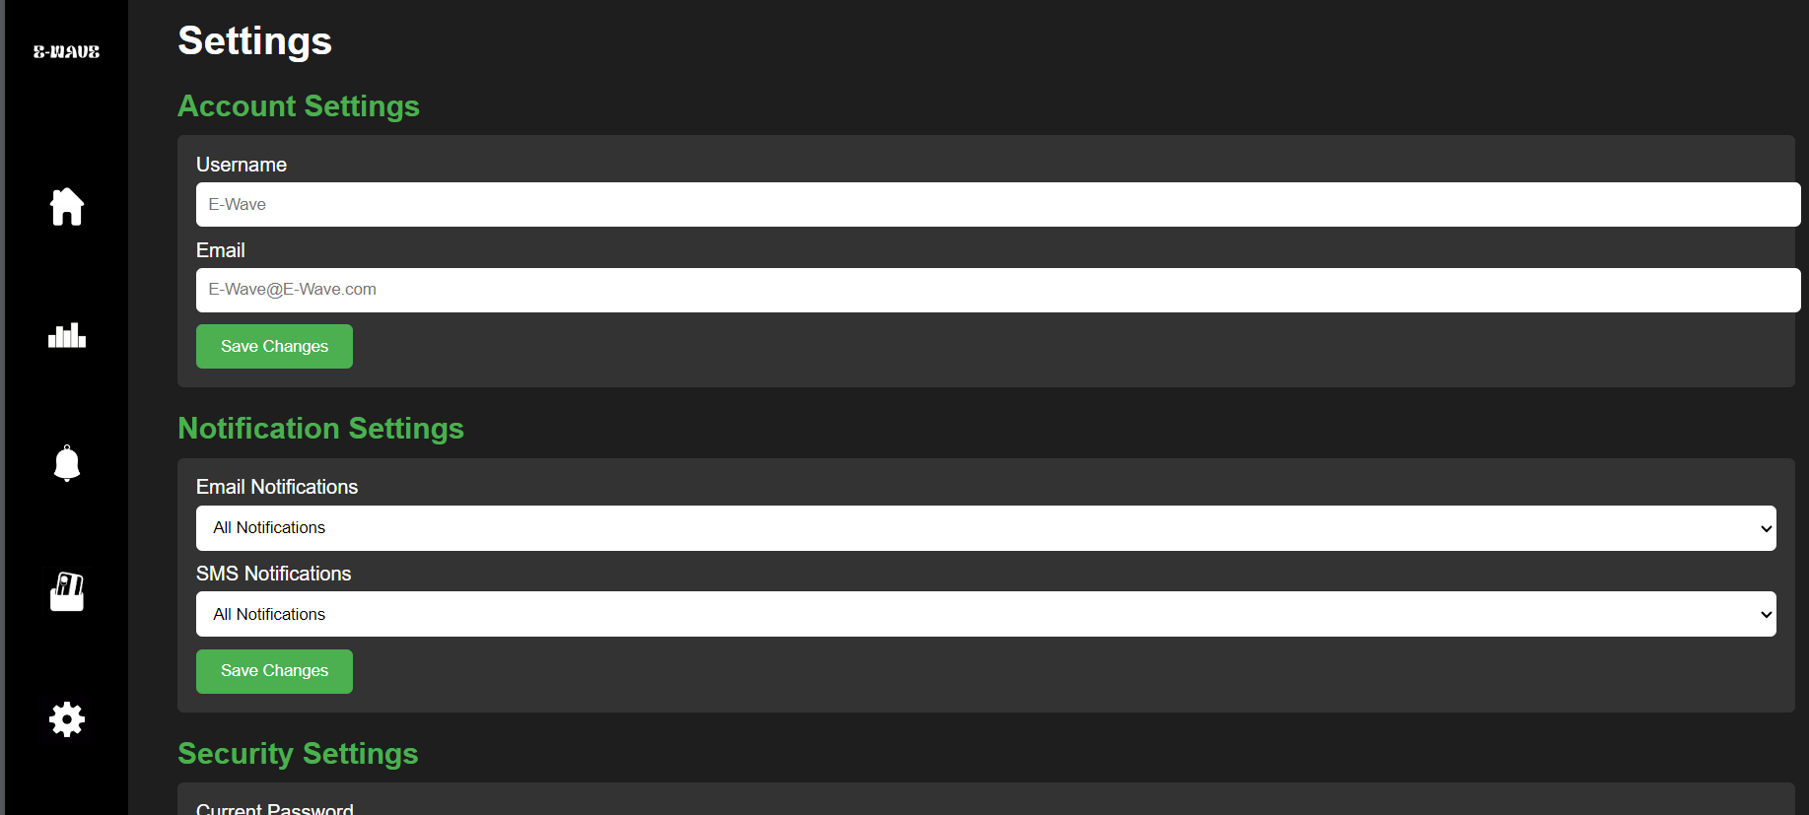
Settings

Slide 20

Cloud Computing
Login Page (c369-ga-cok5.onrender.com)

Slide 21

Thank you Q&A

